Slide 1
PM&R in a Virtual World
Ileana Howard, MD

Slide 2
Financial Disclosure
No financial conflicts of interest to disclose

Slide 3
Warning
Videotaping or taking pictures of the slides associated with this presentation is prohibited. The information on the slides is copyrighted and cannot be used without permission and author attribution.

Slide 4
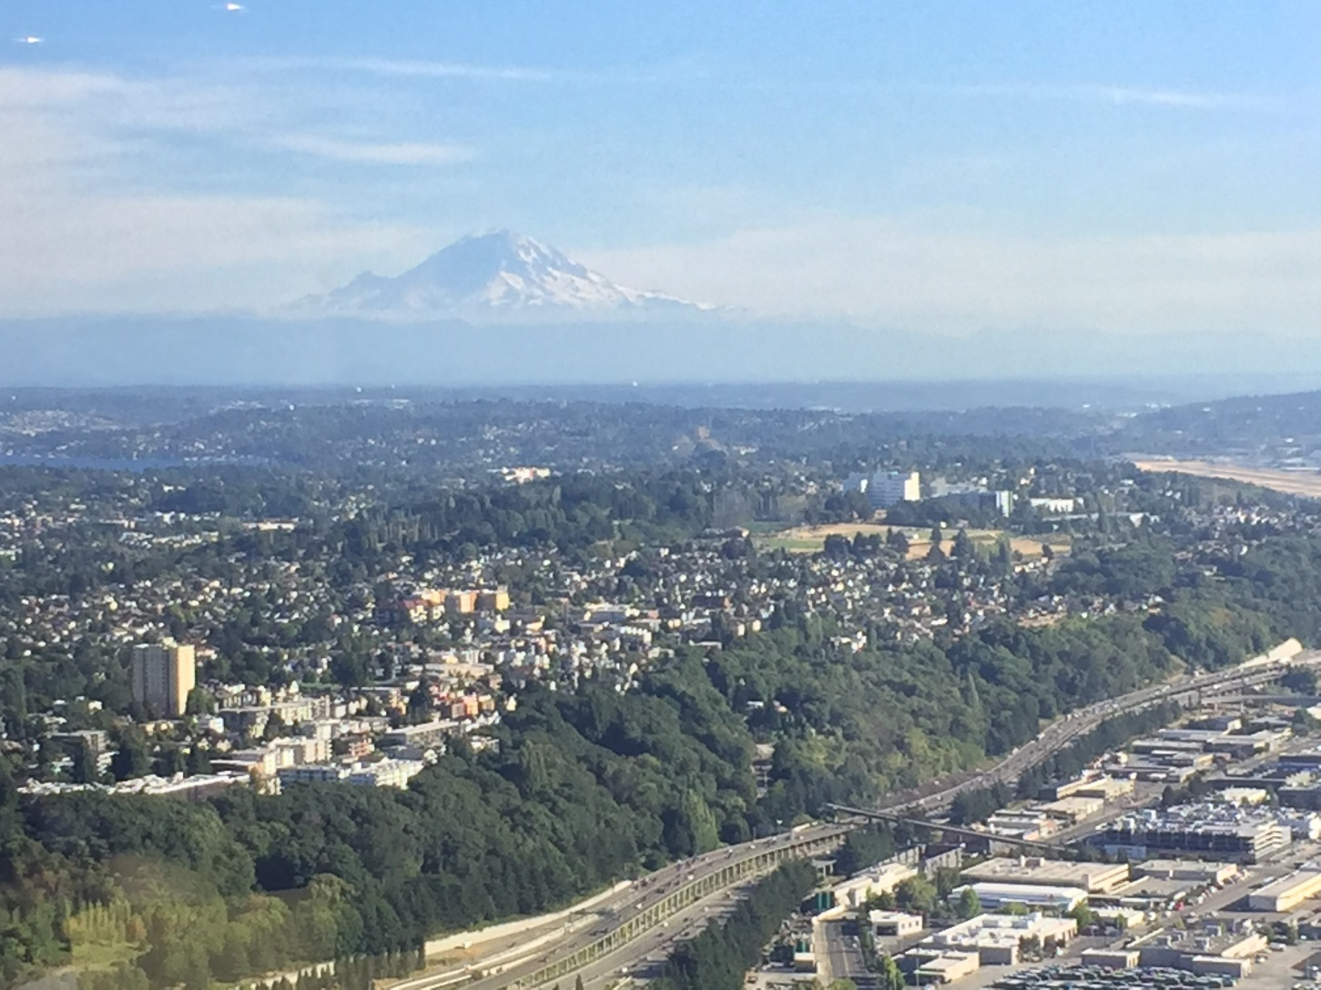
Outline
Sharing our experience
Tips & Tools for expanding telehealth practice
The future of telehealth post-pandemic

Slide 5
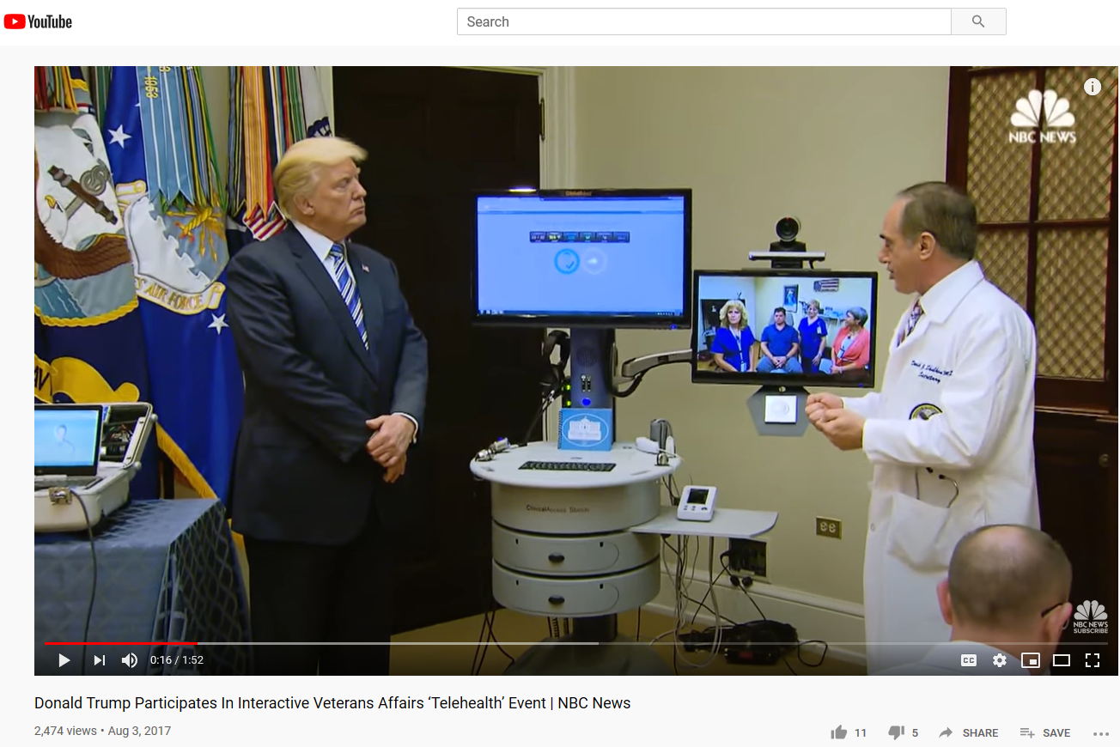
TeleRehabilitation in the Veterans Health Administration
Early implementation
~25% Veteran population considered “rural” dwelling
Steady growth
400% increase unique patients receiving tele-rehabilitation services between 2012 and 2017*
Amputation, brain injury highest numbers
Increasing visibility
Telehealth visit from the White House in 2017
*Cowper-Ripley DC, et. al. Federal Practitioner. 2019

Slide 6
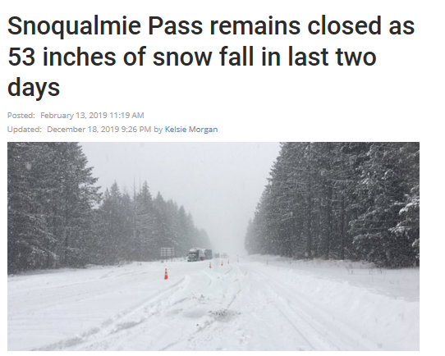
Why I started practicing telehealth
me
my patient

Slide 7
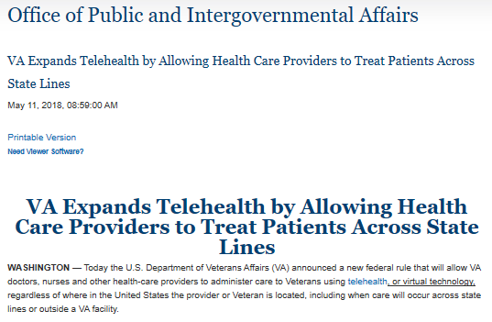
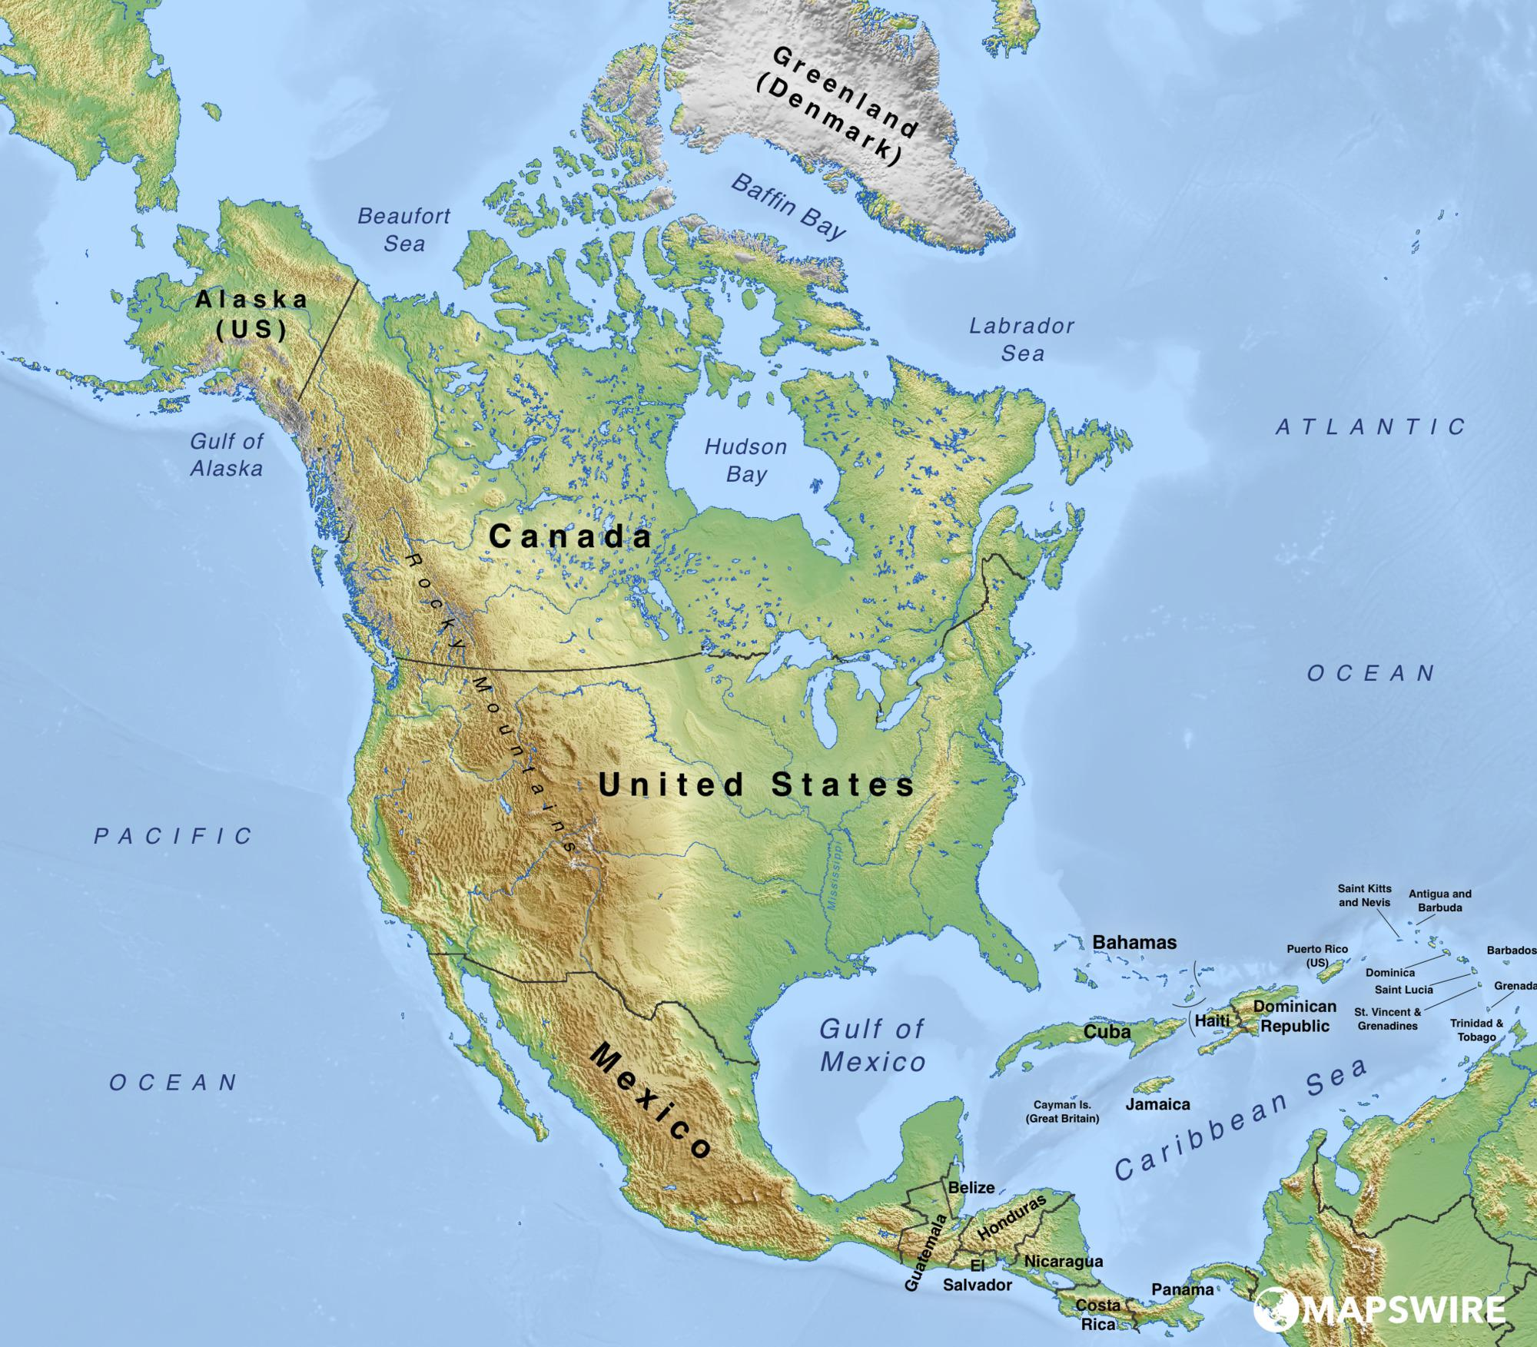
2018: “Anywhere to Anywhere”

Slide 8
Telehealth in Pandemic Times
Expansion of already existing telehealth clinics
MS
ALS
Amputee
TBI
Mobility (Wheelchair) clinic
Rapid expansion, replacement of all non-procedure clinics
Stroke rehab
Spine & Musculoskeletal
Orthotics
Screen/perform H&P prior to procedure clinics
EMG
Pain procedures
Spasticity

Slide 9
Lessons Learned from Expanding Telehealth

Slide 10
Poll: What is the greatest barrier you face towards adopting telehealth?
Not comfortable with the technology
Not comfortable with not having the access to lay hands on the patient for the physical exam
Patients not able or willing to do video visits
Billing
Legislation restrictions

Slide 11
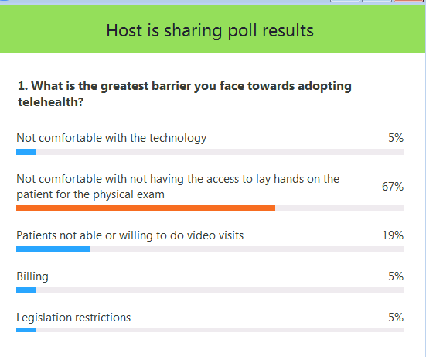

Slide 12
Tip #1: Just Do It (Telehealth)
Identify & Treat Telehealth Hesitancy Syndrome (THHS):
Inability to start or maintain a stream of …clinical video telehealth
Affects healthcare workers and general public
Practice video visits with colleagues
Observe a visit
Review scenarios when things don’t work out
Hybrid visit (telehealth + telephone) when audio doesn’t work
Hanging up and reconnecting

Slide 13
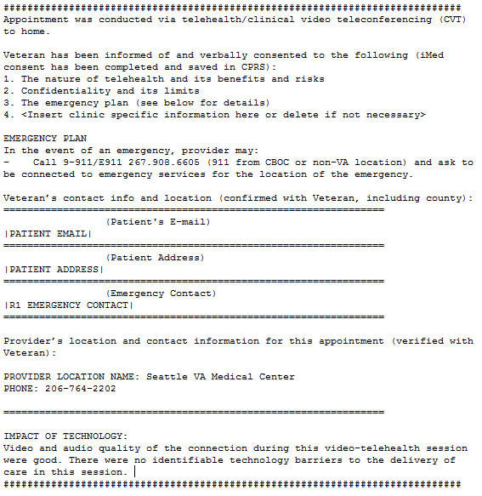
Tip #2: Disseminate Templates
Informed Consent
Emergency Procedures
Telehealth exam templates

Slide 14
Tip #3: Leverage your support staff
Explain the video visit to patients
Perform a test call with the patient prior to the visit
Additional support for late adopters new to the technology
Back-office support to troubleshoot with patient
Comb through clinic cancellations related to COVID-19

Slide 15
Tele-PM&R: additional considerations

Slide 16
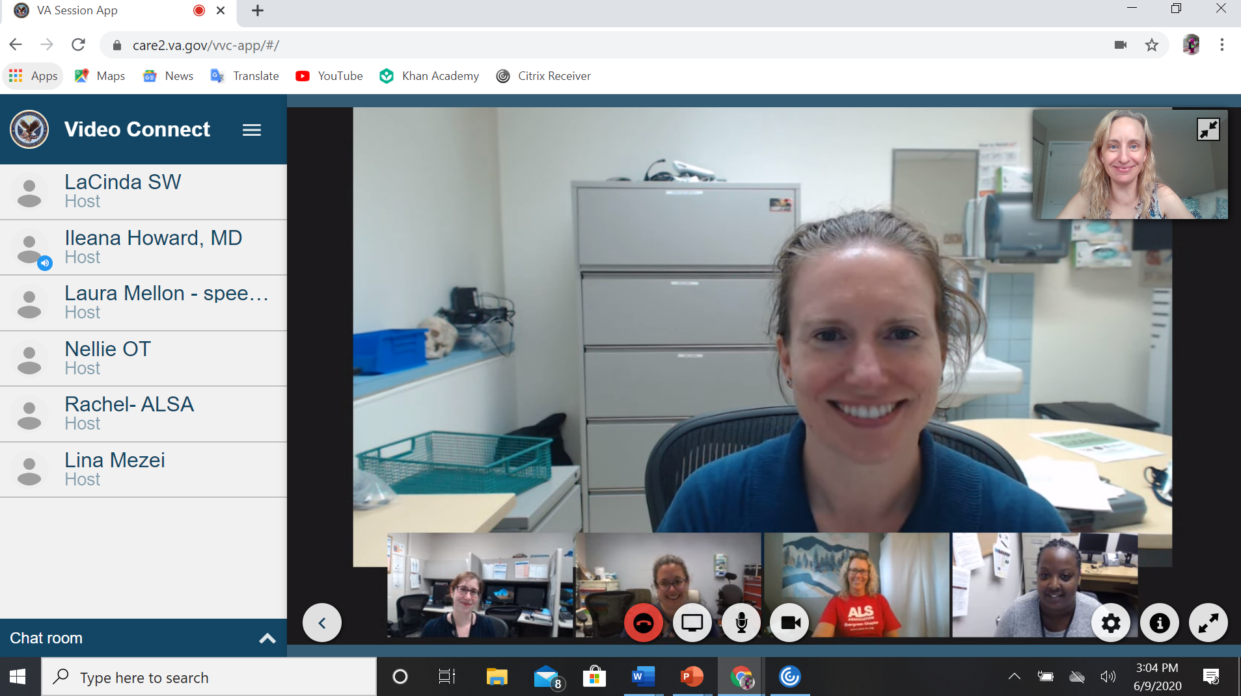
The (Virtual) Interdisciplinary team
Telehealth elevates Interdisciplinary clinic evaluations
Know what resources are available for therapies both in person and through telehealth
Communication through email/instant messaging around and during the visit

Slide 17
Telehealth vs. Telephone
Even limited physical exam has significant value
Establish rapport with the patient
Pick up on non-verbal cues
Glean information about physical environment & caregiver support
Biopsychosocial model
Ability to communicate with a non-verbal patient
Using chat box
Connection through or adjacent to a communication device

Slide 18
Transitioning to the “New Normal”
Virtual Care
F2F

Slide 19
Poll: Do You Plan to Continue Telehealth once Face to Face (F2F) clinic appointments fully resume?
Yes
No
Unsure

Slide 20
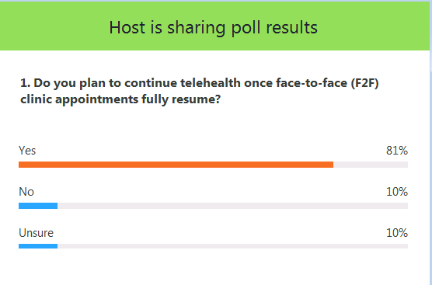

Slide 21
Telehealth and the 6 IOM Quality Aims
Timely
reduce waits and delays
Equitable
care does not vary because of geographic location, disability, co-morbid disease
Patient-Centered
Safe
Can we rule out dangerous conditions without a F2F physical exam
Effective
How can we measure this?
Efficient
What outcomes?
Inputs: time, cost, material

Slide 22
Poll: What tools would be most helpful to you to expand your practice in clinical video telehealth right now?
Sample templates for exam portion
Advocacy to maintain parity in billing
Advocacy to use commonly available video conferencing/ video call systems
Practice telehealth calls with colleagues

Slide 23
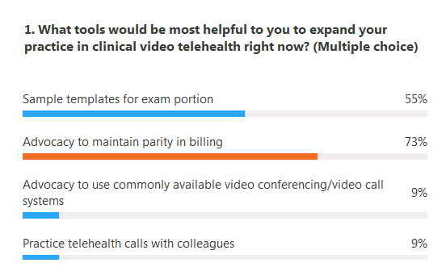

Slide 24
CME Recording
This live webinar can be claimed for up to 1.25 CME. To record your CME go to: https://education.aanem.org/URL/Telehealth
This is free for members. Nonmembers must pay a $25 recording fee.
For members, as a member benefit, we will forward your recorded CME to your primary boards, ABPN or ABPMR.

