Slide 1
ACCREDITATION STATEMENT: The AANEM is accredited by the Accreditation Council for Continuing Medical Education (ACCME) to provide continuing medical education for physicians.
DISCLOSURE INFORMATION: No authors/planners of this activity had relevant conflicts of interest to disclose.
CREDIT DESIGNATION: The AANEM designates this enduring material for a maximum of 1.25 AMA PRA Category 1 Credits TM.
Physicians should claim only the credit commensurate with the extent of their participation in the activity. CEU credit is available for nonphysicians.
Claim your CME at: https://education.aanem.org/URL/Telehealth

Slide 2

Telehealth During COVID-19
Ghazala Hayat, MD

Slide 3
Financial Disclosure
No relevant financial disclosures.

Slide 4
Warning
Videotaping or taking pictures of the slides associated with this presentation is prohibited. The information on the slides is copyrighted and cannot be used without permission and author attribution.

Slide 5
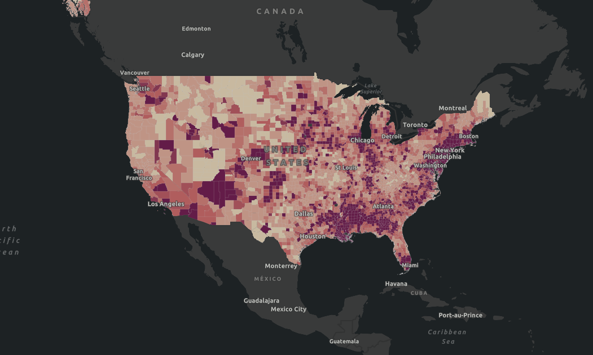

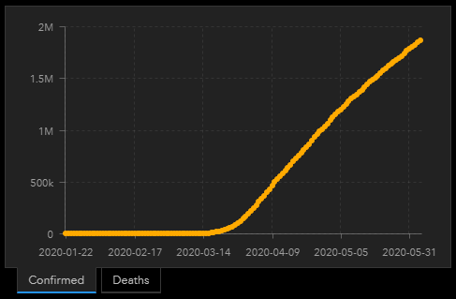
June 5,2020
TOTAL CASES
1,862,656
TOTAL DEATHS
108,064
https://coronavirus.jhu.edu/map.html

Slide 6

Risk of acquired infection
Risk of transmission
Risk from interrupted care

Slide 7

Benefits of Telemedicine
Decreased risk of transmission*
Advantages for patients: Convenience
Increased access
Advantages for physicians: Lower no show rate
Flexibility of space and time
Higher patient satisfaction
Barriers: Technological unavailability/unfamiliarity
Cognition
Physical Limitations

Slide 8
Limitations of Telemedicine
Limitation of neuromuscular examinations*
Loss of personal interaction
Technological disruption
Delay in obtaining laboratory and neurodiagnostic tests
Limitations in performance of pulmonary function tests
Possibility of breach of patient confidentiality
Shortage/lack of computers with cameras
Training &Teaching
New ways, some limitations of supervision, “Can be done”

Slide 9
Acuity Stratification
Acute e.g. Guillain-Barre Syndrome
Subacute e.g. Autoimmune myopathies/neuropathies
Chronic Relapsing e.g. Myasthenia syndromes
Chronic Progressive e.g. Motor neuron disorders
Chronic Stable e.g. Treated nutritional polyneuropathies
Everything is a shade of grey, please use your judgement

Slide 11
Differing State Laws
Missouri Missouri requires that providers obtain patient consent, and consent is specifically required prior to asynchronous (store-and-forward) services to ensure confidentiality of medical records. Additionally, parents/guardians must provide consent for school-based health services. APRNs must also receive informed consent. The Medicaid program requires written informed consent.
New Mexico New Mexico does not require getting a patient’s consent before a telemedicine visit. However, we recommend doing this anyway as a telemedicine best practice.
Check Your State Law

Slide 12
Polling Question
How much time do you spend on a telehealth visit? (Single choice)
Answer 1. Same as a face to face visit
Answer 2. More than a face to face visit
Answer 3. Less than a face to face visit

Slide 13
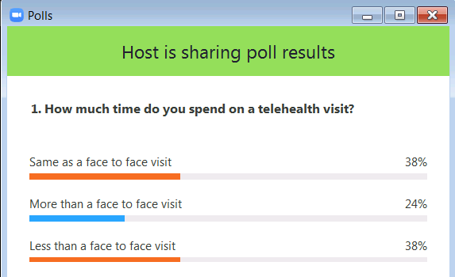

Slide 14
Polling Question
2. What are your patients’ satisfaction level with the telehealth visits? (Single choice)
Answer 1. Very satisfied
Answer 2. Somewhat satisfied
Answer 3. Neutral
Answer 4. Somewhat dissatisfied
Answer 5. Very dissatisfied

Slide 15
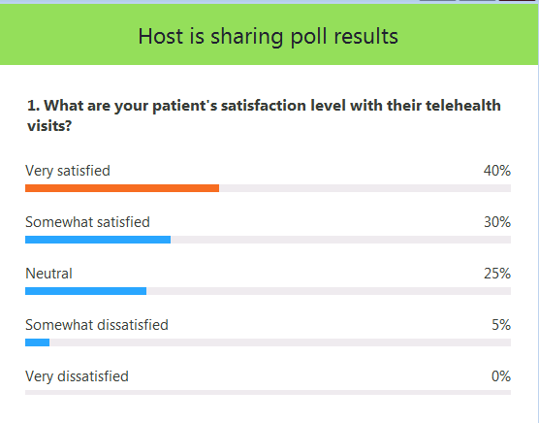

Slide 16
Polling Question
3. As a healthcare provider what is your satisfaction level with the telehealth? (Single choice)
Answer 1. Very satisfied
Answer 2. Somewhat satisfied
Answer 3. Neutral
Answer 4. Somewhat dissatisfied
Answer 5. Very dissatisfied

Slide 17
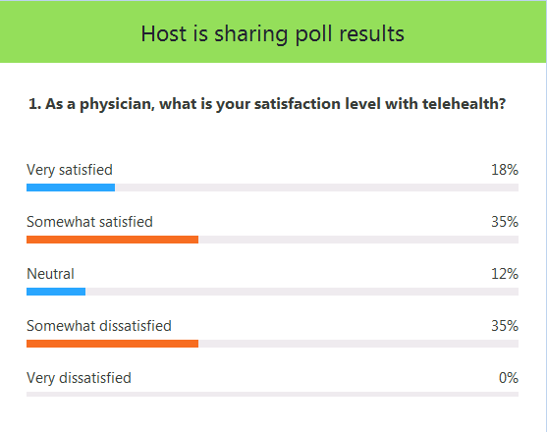

Slide 18
Consent For Telemedicine
Telemedicine; best to require consent and verification
Staff to explain the procedure before the appointment
Confirm the patient’s name, DOB
Document the consent in the chart; use smart text
Typically require licensure of the state where the patient is located
Law varied from state to state

Slide 19
Recommendations
Internet speed:1.2 Mbps minimum
Professional background setup
Be on time, if running late make sure patient is contacted.
Maintain eye contact
Enunciate questions
Send detailed summary to patient after visit, e.g. MyChart

Slide 20
Telemedicine Examination
Vitals Some patients may have access to home machines
Most patients have access to weight/height measurement
Mental Status Orientation
MMSE
Cranial Nerves CN 3, 4, 6, 7, 11 & 12 (To some extent 5, 8, 9, 10)
Motor Tapping to assess tone
Visual inspection of bulk
MRC Grading 0 - (1/2) - 3 - (4/5)

Slide 21
Telemedicine Examination
Movements Visual inspection of tremors (resting/kinetic; fine/coarse)
Cerebellar Finger to nose
Rapid alternating movements
Gait Stance, stride (Require caregiver assistance for testing*)
Subjective functional measurement e.g. ALSFRS-R, MG-ADL, MG-QOL
Other examinations e.g. Gaze provoked ptosis, Single breath count
Caregiver can assist examination, so count on spending more time than your regular visit.

Slide 22
Pearls For Efficiency of Telemedicine
Medication reconciliation by staff prior to visit
Pre-charting: Past medical history
Family history
Social history
ROS forms to be scanned beforehand if possible

Slide 23
Reimbursement
Telephone Visits Initially billed at a lower rate, however CMS working with insurers to retro-bill the initial encounters to reimburse at a higher rate.
Video Visits Bill at the same rate as an in-person clinic visit
Most insures allow for on demand telemedicine visits as they are generally less expensive visits.

Slide 24
Conclusion
Telemedicine has the ability to transform our practice.
Inservice Education for providers, staff and patients will make appointments easier to navigate.
Open opportunities for clinical growth and access to patients
Wider spread of use will allow more conditions to be seen
Population that embraces technology is at the forefront
Training and Education is vital for patients that has difficulty utilizing current technology
Opportunities for training in different work skills

Slide 25
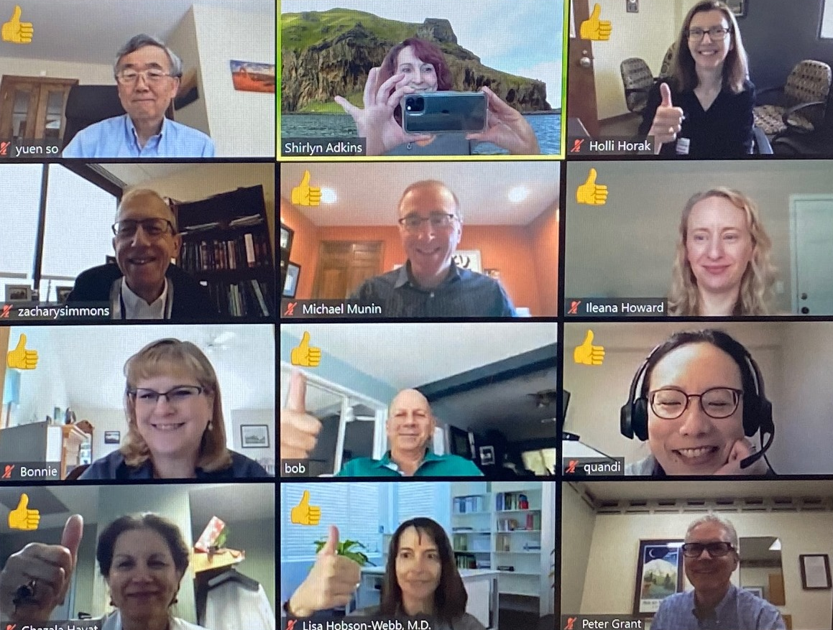
THANK YOU

