Slide 1
Basics of Nerve Conduction Studies
Review
Diana Mnatsakanova
Neuromuscular Fellow
Utilized as a study resource for the CNCT examination by AANEM/ABEM with permission from Diana Mnatsakanova.

Slide 2
Objectives
Motor nerve conduction studies
Sensory nerve conduction studies
Principles of stimulation
Important basic patterns
Review of cases

Slide 3
Overview
Peripheral nerves are easily stimulated and brought to action potential
Motor, sensory and mixed nerves studied
Nerves studied the most
  Upper extremity: median, ulnar, and radial
  Lower extremity: peroneal, tibial, and sural
Motor nerve responses range in milivolts (mV)
Sensory nerve responses range in microvolts (μV)

Slide 4
Motor Conduction Studies
Belly-tendon montage
Active electrode G1 is placed over center of muscle belly (motor endplate)
Reference electrode G2 is placed over muscle tendon
Stimulator is placed over the nerve (cathode placed closest to G1)
Gain is set at 2-5 mV per division
Duration of electrical impulse is set at 200 ms
Normal nerve requires a current in the range of 20-50 mA for supramaximal stimulation

Slide 5
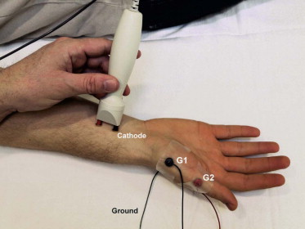
Motor Conduction Studies

Slide 6
Motor Conduction Studies
Compound Muscle Action Potential (CMAP)
  Summation of all individual muscle fiber action potentials
  Biphasic potential with initial negative (upward) deflection
Supramaximal stimulation – current increased to the point where CMAP no longer increases in size (all nerve fibers have been excited)
Latency, Amplitude, Duration, and area of CMAP are measured

Slide 7
Compound Muscle Action Potential
Latency – time from stimulus to the initial CMAP deflection from baseline
  Measurements in ms; reflect the fastest conducting motor fibers
Amplitude – from baseline to negative peak
  Reflects number of muscle fibers that depolorize
  Low CMAP result from axon loss, conduction block, NMJ d/o, myopathies
Area – baseline to the negative peak – measured by EMG machines
  Differences in CMAP areas between distal and proximal stimulation sites helps evaluate for conduction block
Duration – from initial deflection from baseline to the first baseline crossing
  Measure of synchrony (some motor fibers conduct slower than the others causing increased duration, i.e. in demyelinating diseases)

Slide 8
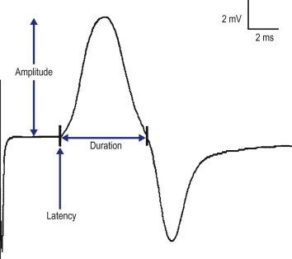
Compound Muscle Action Potential

Slide 9
Conduction velocity
Motor conduction velocity – measure of the speed of the fastest conducting motor axons in the stimulated nerve
  Velocity = Distance/Time in m/s
Cannot be calculated by single stimulation due to multiple parts of conduction
  Conduction time along motor axon to NMJ
  NMJ transmission time
  Muscle depolarization time
Thus two stimulation sites are used to calculate accurate conduction velocity
  Final conduction time used = proximal latency – distal latency = (A+B+C+D)- (A+B+C) = D

Slide 10
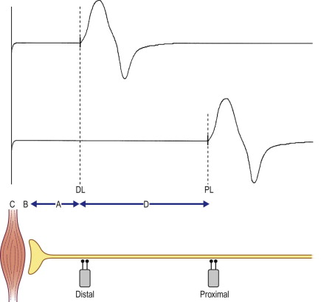
Conduction velocity

Slide 11
Sensory Conduction Studies
Sensory responses are very small (1-50 μV)
Electrical noise and technical factors are more significant
Only nerve fibers are assessed
Gain is set at 10-20 μV per division
Normal sensory nerve requires current in the range 5-30 mA
Sensory conduction velocity can be calculated with one stimulation site
SNAP duration is shorter compared with CMAP duration (1.5 ms vs 5-6 ms)

Slide 12
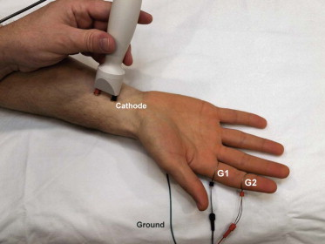
Sensory Conduction Studies

Slide 13
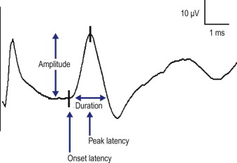
Sensory Nerve Action Potential

Slide 14
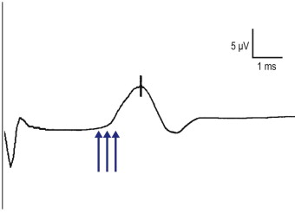
SNAP Onset vs Peak Latency
Notes:
Each have their own advantages and disadvantages. Onset latency represents fastest conducting fivers and can be used to calculate CV. However, difficult to precisely place the latency marker on the initial deflection from baseline. Peak latency – easily marked, no inter-examiner variation; cannot be used to calculate conduction velocity.

Slide 15
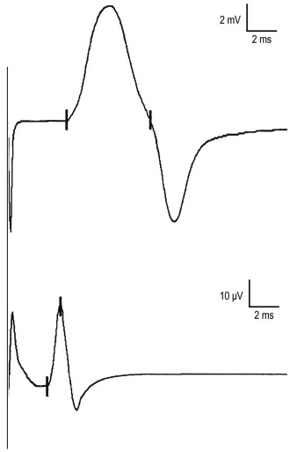
CMAP vs SNAP
Notes:
CMAP amplitude usually is measured in millivolts, whereas SNAPs are small potentials measured in the microvolt range (note different gains between the traces). CMAP negative peak duration usually is 5 to 6 ms, whereas SNAP negative peak duration is much shorter, typically 1 to 2 ms.

Slide 16
Sensory Antidromic vs Orthodromic Recording
Nerve depolarized=> conduction occurs equally in both directions
Antidromic – stimulating toward the sensory receptor
Orthodromic – stimulating away from the sensory receptor
Latency and conduction velocity should be identical with either method
  Amplitude is higher in antidromic stimulation
Antidromic technique is superior – higher amplitude

Slide 17
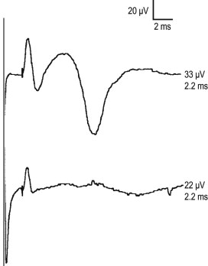
Sensory Antidromic vs Orthodromic Recording

Slide 18
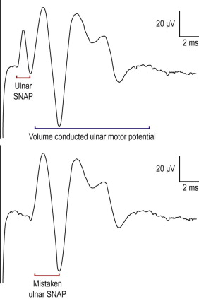
Sensory Antidromic Recording
Notes:
Volume conducted motor potential

Slide 19
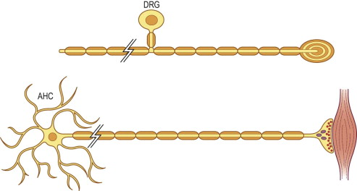
Lesions proximal to DRG
Notes:
Bipolar cells outside spinal cord near the intervertebral foramina.
Any lesion of the nerve root leaves dorsal root ganglion and its peripheral axon intact.
SNAPS remain normal in lesions proximal to the dorsal root ganglia including lesions of the nerve roots, spinal cord, and brain

Slide 20
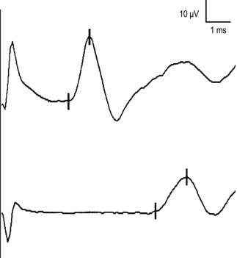
Proximal Stimulation
Notes:
proximal stimulation results in sensory nerve action potentials (SNAPs) that are longer in duration and lower in amplitude and area. This occurs as a result of normal temporal dispersion and phase cancellation

Slide 21
Principles of stimulation
Supramaximal stimulation – current increased to the point where CMAP no longer increases in size (all nerve fibers have been excited)
Submaximal stimulation – current is low
Co-stimulation- current is too high and depolarizes nearby nerves

Slide 22
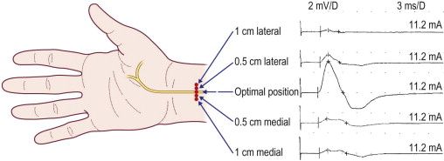
Optimizing stimulator position

Slide 23
Important basic patters
Neuropathic lesions
  Axonal vs demyelinating
  Axon loss: toxic, metabolic, genetic conditions or physical disruption
  Demyelination: dysfunction of myelin sheath can be seen with entrapment, compression, toxic, genetic, immunologic causes

Slide 24
Axonal loss
Most common pattern on NCS
Reduced amplitude is the primary abnormality associated with axonal loss
Conduction velocity and latency are normal vs mildly slowed; marked slowing does not occur
CV does not drop lower than 75% of lower limit of normal
Latency prolongation does not exceed 130% of the upper limit of normal
Exception – hyperacute axonal loss (nerve transection/nerve infarction) NCS within 3-4 days are normal
  Wallerian degeneration between 3-5 days for motor n; 6-10 for sensory n.
  With distal stimulation amplitude is normal; with proximal stimulation amplitude is lowered and simulates conduction block aka pseudo-conduction block
Notes:
In the median nerve, for instance, the largest-diameter (and accordingly the fastest) myelinated fibers conduct at a velocity of approximately 65 m/s. At the other end of the normal range, there are slower fibers that conduct as slowly as 35 m/s.

Slide 25
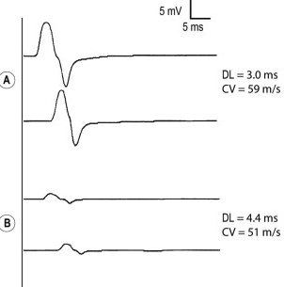
Axonal loss

Slide 26
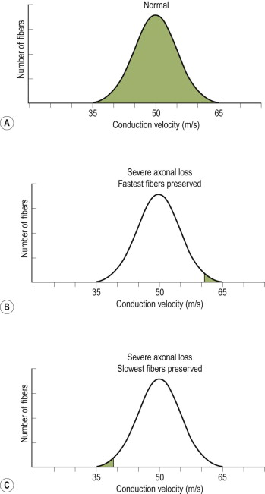
Axonal loss

Slide 27
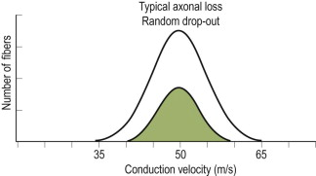
Axonal loss

Slide 28
Demyelination
Myelin is essential for saltatory conduction
Marked slowing of CV (<75% of lower limit of normal)
Marked prolongation of distal latency (>130% of the upper limit of normal)
If CV and latency is at the cutoff – look at the amplitude
In demyelinating d/o sensory amplitudes are low/absent – d/t temporal dispersion/phase cancelation
Reduced amplitudes in demyelinating lesions is due to conduction block or secondary axon loss in late stage of disease

Slide 29
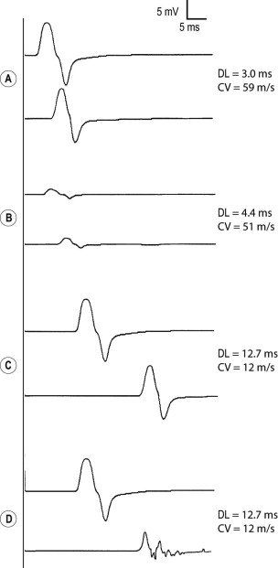
Demyelination

Slide 30
Conduction Block
Seen in acquired demyelinating diseases
Reduced amplitudes between proximal and distal stimulation sites
Drop in CMAP area by >50%
Temporal dispersion and phase cancelation in demyelinating diseases can look like conduction block but if CMAP area drops by >50%, this is due to conduction block

Slide 31
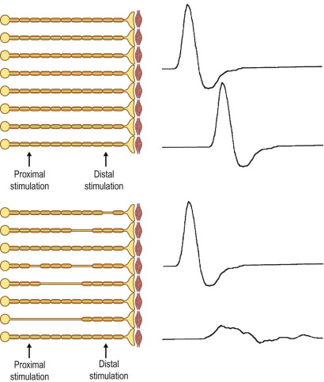
Conduction Block

Slide 32
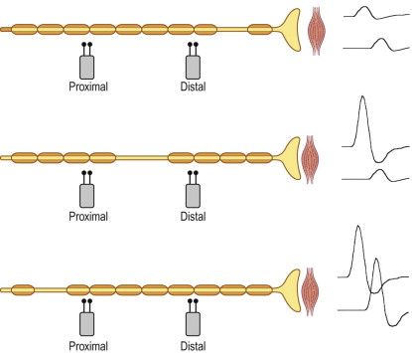
Conduction Block

Slide 33
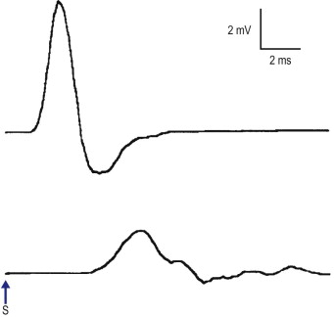
Conduction Block

Slide 34
F waves
Stimulation of the motor nerves towards the spinal cord and recording at the muscle belly
F waves are brought on by supramaximal stimulation, have varying latencies and morphology.
F waves are usually prolonged in demyelinating neuropathies such as AIDP/CIDP

Slide 35
H reflexes
EMG correlate of ankle reflex (tibial nerve), less commonly in the forearm
Stimulation of 1a sensory fibers of the tibial nerve towards the spinal cord and recording at the gastrocnemius muscle belly
H waves are suppressed by supramaximal stimulation, have constant latencies
Useful for S1 radiculopathies

Slide 36
NCS Patterns
Radiculopathy - will have normal sensory conduction studies and abnormal motor NCS
  The sensory root is presynaptic and therefore not tested on NCS
  With the exception to superficial fibular nerve which is affected in L5 radiculopathy (in real life)
Plexopathy should have abnormal sensory conduction studies
Low motor amplitudes only – think of motor neuron disease, myopathy, and LEMS(Lambert Eaton Myasthenic syndrome)
LEMS - very low motor conduction amplitudes, in absence of other findings
  Post exercise facilitation – increase in motor amplitude after short exercise
Martin Gruber anastomosis – anatomic variant in 30% of the population
  Median nerve partial innervation of ulnar innervated muscles (ADM, FDI)
  Distal median motor amplitude is smaller than proximal
  Distal ulnar motor amplitude is significantly larger than proximal

Slide 37
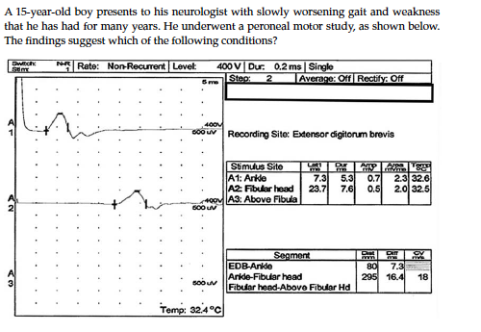
Case 1
Axonal neuropathy
Demyelinating neuropathy
Conduction block at the fibular head

Slide 38
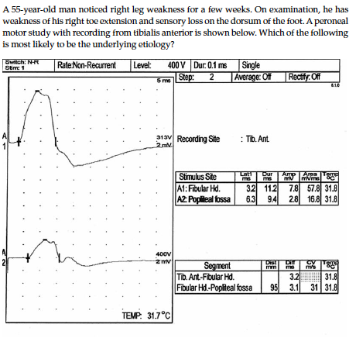
Case 2
L5 radiculopathy
Peripheral neuropathy
Conduction block at the fibular head

Slide 39
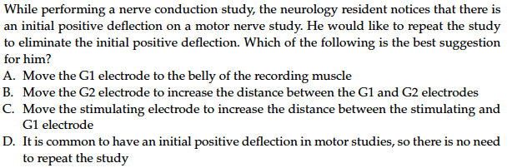
Case 3

Slide 40
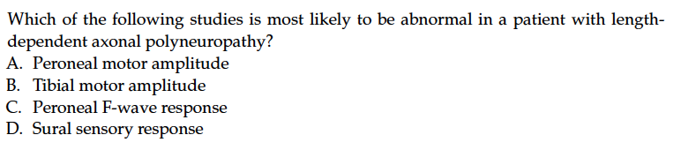
Case 4

Slide 41
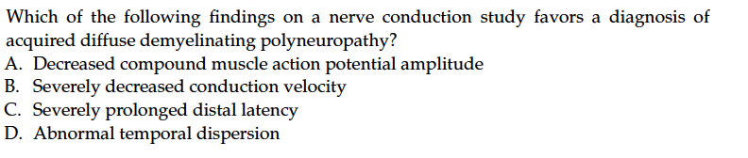
Case 5

Slide 42
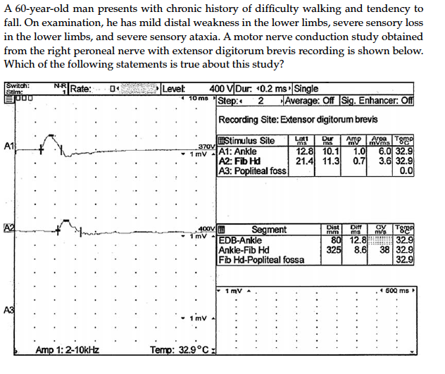
Case 6
It suggests acquired demyelinating polyneuropathy
It suggests axonal polyneuropathy
It is a normal peroneal motor study for age

Slide 43
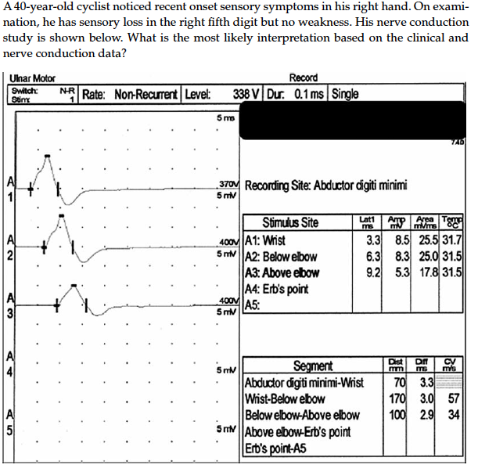
Case 7
Ulnar neuropathy at the wrist
Ulnar neuropathy at the elbow
Medial cord or lower trunk plexopathy

Slide 44
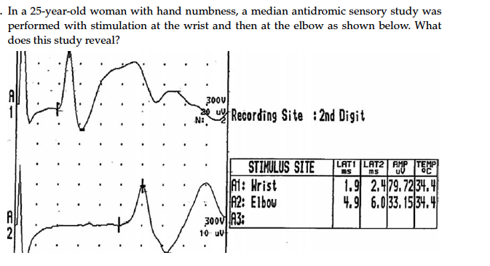
Case 8
A conduction block in the forearm
Abnormal temporal dispersion in the forearm
Normal median sensory study
Carpal tunnel syndrome

Slide 45
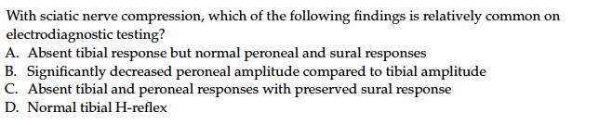
Case 9

Slide 46
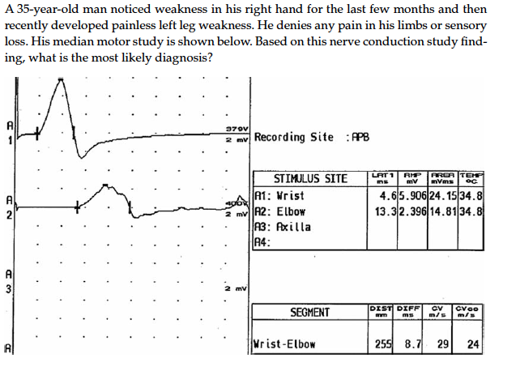
Case 10
Carpal tunnel syndrome
Multifocal motor neuropathy
Lower trunk brachial plexopathy

Slide 47
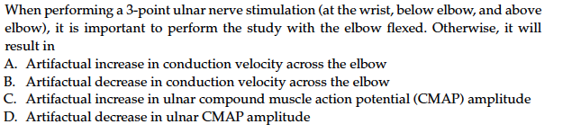
Case 11

Slide 48
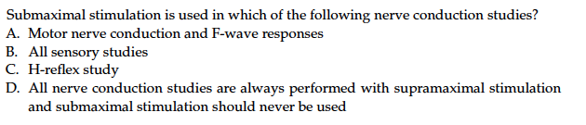
Case 12

Slide 49
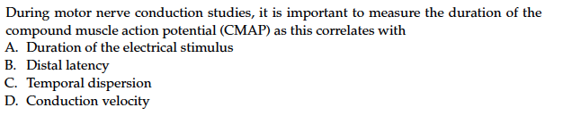
Case 13

Slide 50
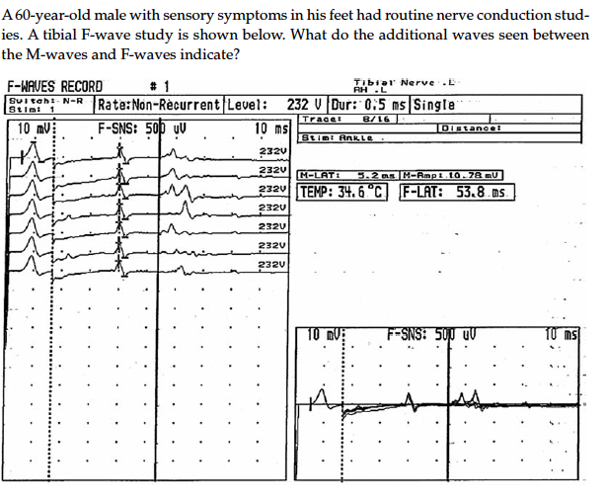
Case 14
Electrical artifacts
A-waves
Excess patient movement with each stimulation

Slide 51
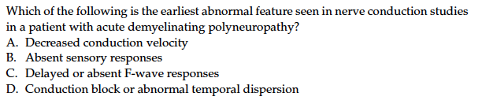
Case 15

Slide 52
References
Preston and Shapiro. 2013. Electromyography and Neuromuscular Disorders. Third Edition.
Clinical Neurophysiology Board Review Q&A.

